Slide 1
CHAPTER 24
The Multiplier Model (Samuelson Book Ref)

Slide 2
The Multiplier Model
The United States and other market-oriented economies are subject to frequent and unpredictable fluctuations in output, prices, and unemployment.
In the past, these fluctuations, known as business cycles, generally occurred because of changes in spending on investment, consumer durables, or defense.
As economists, we want to understand the mechanism by which changes in spending get translated into changes in output and employment.
This chapter develops the simplest approach to understanding business cycles, the Keynesian multiplier model.

Slide 3
Cont.,
We will see in the first part of this chapter how an increase in investment raises the incomes of consumers and further spending increases.
Investment changes are therefore multiplied into larger output increases.

Slide 4
The Basic Multiplier Model
What exactly is the multiplier model? It is a macroeconomic theory used to explain how output is determined in the short run.
The name "multiplier“ comes from the finding that each rupee change in exogenous expenditures (such as investment) leads to more than a rupee change (or a multiplied change) in GDP.
The multiplier model explains how to investment, foreign trade, and government tax and spending policies can affect output and employment in an economy.

Slide 5
Continued
The key assumptions underlying the multiplier model are that wages and prices are fixed and that there are unemployed resources.
In addition, we are suppressing the role of monetary policy and assuming that there are no financial—market reactions to changes in the economy.

Slide 6
Output determination with Saving and investment
We first show how investment and saving are equilibrated in the multiplier model for a highly simplified economy.
Recall Chapter of the national consumption and saving functions; these are drawn in Figure 24-1.1
Each point on the consumption function shows desired or planned consumption at that level of disposable income. Each point on the saving schedule shows desired or planned saving at that income level. The two schedules are closely related: Since C + S always equals disposable income, the consumption and saving curves are mirror twins that will always add up to the 45° line. We also carry over the SS schedule into Figure 24-2

Slide 7
Cont.,
We have seen that saving and investment are dependent on quite different factors: saving depends primarily on disposable income, while investment depends on factors such as output, interest rates, tax policy, and business confidence.
For simplicity here, we treat investment as an exogenous variable, one whose level is determined outside the model.

Slide 8
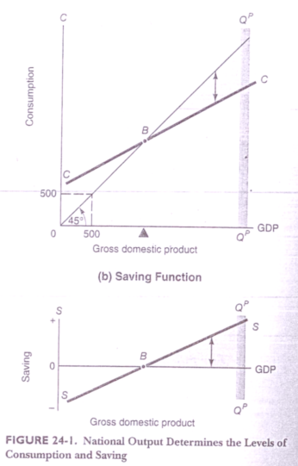

Slide 9
Cont.,
Recall from Chapter 22 the consumption and saving functions, CC and SS.
These are mirror-image curves, so the break-even point at B on the upper diagram is the zero saving point on the lower diagram where SS intersects the horizontal axis. The two points in (a) marked “500” emphasize the important property of the 45° line;
Any point on it depicts a vertical distance exactly equal to the horizontal distance. The gray band marked Q^{P}Q^{P} shows the level of potential GDP.

Slide 10
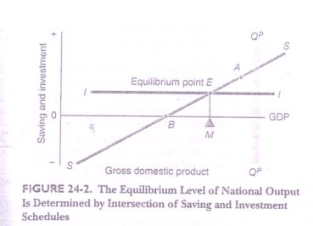

Slide 11
Cont.,
The horizontal line indicates constant investment. E marks the spot where the investment and saving curves intersect. Equilibrium GDP comes at the intersection of the SS and II curves because this is the only level of GDP at which the desired saving of households exactly matches the desired investment of business.
The saving and investment schedules intersect point E in Figure 24—2. This point correspond to a level of GDP given at point M and represents the equilibrium level of output in the multiplier model. This intersection of the saving and investment schedules is the equilibrium level of GDP toward which national output will gravitate.

Slide 12
Cont.,
Looking now at Figure 24-2, we see that point E is an equilibrium. The reason is that at this level of output, the desired saving of households equals the desired investment of firms.
When desired saving and desired investment are not equal, output will tend to adjust up or down

Slide 13
Cont.,
The saving and investment schedules shown in Figure 24-2 represent desired (or planned) levels. Thus at output level M, businesses will want to invest an amount equal to the vertical distance ME.
Also, at that income level, households desire to save the amount ME.
But there is no logical necessity for actual saving to equal planned saving (or for actual investment to equal planned investment). People can make mistakes. Or they may forecast events incorrectly when mistakes happen, saving or investment H might deviate from planned levels.

Slide 14
Cont.,
To see how output adjusts until desired saving and desired investment are equated, we consider three cases.
In the first case, the system is at E, where the schedule of what business firms want to invest intersects the saving schedule of what households want to save.
When everyone’s plans. are satisfied, everyone will be content to go on doing just what he or she has been doing.

Slide 15
Cont.,
At equilibrium, firms will not find inventories piling up on their shelves, nor will their sales be so brisk as to force them to produce more goods.
So production, employment, income, and spending will remain the same. In this case GDP stays at point E, and we can rightly call it an equilibrium.

Slide 16
Cont.,
The second case—of a disequilibrium—begins with a GDP higher than at E.
Consider point A, where GDP is to the right of M at an income level where the saving schedule is higher than the investment schedule.
This is not an equilibrium because at this income level households are saving more than business firms want to invest.
Firms will have too few customers and larger inventories of unsold goods than they want. What can businesses do to correct this situation? They can cut back production and dismissed workers.
This response reduces GDP, moving output leftward in Figure 24-2. The economy returns to equilibrium when it gets back to E and has no further tendency to change.

Slide 17
Cont.,
At this point, you should be able to analyze the third case. Show that if GDP were below its equilibrium level, strong forces would be set up to move it eastward back to E.

Slide 18
All the three cases leads to same conclusion
The equilibrium level of GDP occurs at point E. where planned saving equals planned investment. At any other output, the desired saving of household differs from the desired investment of businesses.
This difference will cause businesses to change their production and employment levels. thereby returning the system to the equilibrium GDP.

Slide 19
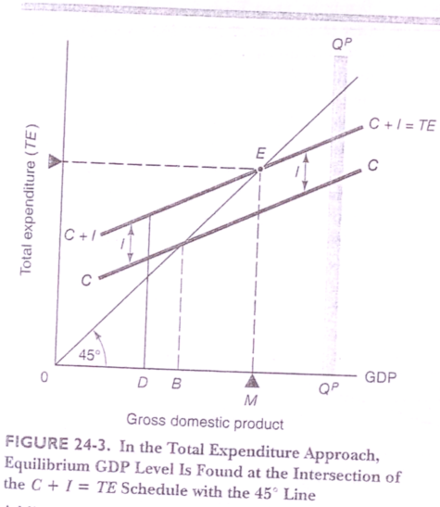
Output Determined By Total Expenditures

Slide 20
Cont.,
The total expenditure curve (TE) shows the level of desired expenditure by consumers and businesses corresponding to each level of output.
The economy is in equilibrium at the point where the TE = C + I curve crosses the 45° line—at point E in Figure 24-3.
At point E the economy is in equilibrium because at that level desired expenditure on consumption and investment exactly equals the level of total output.

Slide 21
The Adjustment Mechanism
We will pause to emphasize why point E is an equilibrium. An economy is in equilibrium when planned expenditure (an C and l) equal: planned output.
What would happen if the system were to deviate from equilibrium, say, at output level D in Figure 24—3? At this level of output, the C + I spending line is above the 45° line, so planned C + I spending would be greater than planned output,
This means that consumers would be buying more goods than businesses were producing. Auto dealers would find their lots emptying, and the backlog for computers would be getting longer and longer.

Slide 22
An Arithmetic Analysis
If the firms are temporarily producing 4200 billion $ of GDP, planned or desired spending is only 4000 billion $. In this situation excess inventories will accumulating. Firm will respond by contracting their operations and GDP will fall.
Opposite case is reported in the bottom row. Inventories are being depleted and firm will expand operations, raising output.

Slide 23
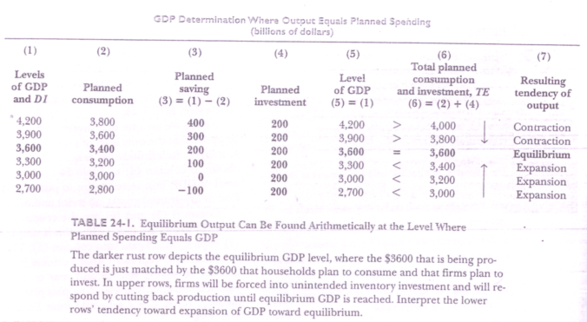

Slide 24
The Multiplier
Where is the multiplier in all this? To answer this question, we need to examine how a change in exogenous investment spending affects GDP. It is logical that an increase in investment will raise the level of output and employment.
But by how much? The multiplier model shows that an increase in investment will increase GDP by an amplified or multiplied amount—by an amount greater than itself.

Slide 25
Cont.,
The multiplier is the impact of 1—doller change in exogenous expenditures on total output. In the simple C + I model. the multiplier is the ratio of the change in total output to the change in investment.

Slide 26
Cont.,
For example, suppose investment increases by $100 billion. If this causes an increase in output of $300 billion, the multiplier is 3. If, instead, the resulting increase in output is $400 billion, the multiplier is 4.

Slide 27
Cont.,
Woodsheds and Carpenters. Why is it that the multiplier is greater than one? Let’s suppose that I hire unemployed resources to build a $1000 woodshed. My carpenters and lumber producers will get an extra $1000 of income. But that is not the end of the story.
If they all have a marginal propensity to consume of 2/3, they will now spend $666.67 on new consumption goods. The producers of these goods will now have extra incomes of $666.67. If their MPC is also 2/3, they in turn will spend $444.44, or 2/3 of $666.67 (or2/3 of 2/3 of $1000). The process will go on, with each new round of spending being 2/3 of the previous round.

Slide 28
Cont.,
Thus an endless chain of secondary consumption spending is set in motion by my primary investment of $1000. But, although an endless chain, it is an ever diminishing one. Eventually it adds up to a finite amount.

Slide 29
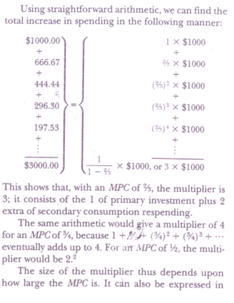
Cont.,

Slide 30
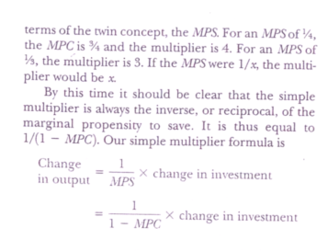
Cont.,

Slide 31
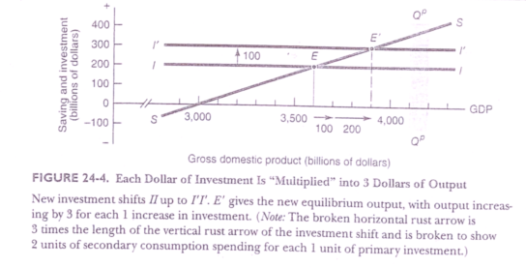
Graphical Picture of the Multiplier

Slide 32
Cont.,
A look at Figure 24-4 can confirm this result. Our old investment schedule II is shifted upward by $100 billion to the new level I'I'.
The new intersection point is E'; the increase in income is exactly 3 times the increase in investment. As the rust arrows show, the horizontal output distance is 3 times as great as the upward shift in the investment schedule.
We know that desired saving must rise to equal the new and higher level of investment. The only way that saving can rise is for national income to rise. With an MPS of % and an increase in investment of $100 billion, income must rise by $300 billion to bring forth $100 billion of additional saving to match the new investment.
Hence, at equilibrium, $100 billion of additional investment induces $300 billion of additional income, verifying our multiplier arithmetic.

Slide 33
The Multiplier Model Compared with the AS-AD Model
As you study the multiplier model, you might begin to wonder how this model fits in with the AS-AD model of Chapter 20.
These are not, in fact, different approaches. Rather, the multiplier model is a special case of the aggregate demand—and-supply model. It explains how AD is affected by consumption and investment spending under certain precise assumptions.

Slide 34
Cont.,
One of the key assumptions in the multiplier analysis is that prices and wages are fixed in the short run. This is an oversimplification, for many prices and just quickly in the real world.
But this assumption captures the point that if some wages and prices are sticky-which is most definitely the case—then some of the adjustment to AD shifts will come through out- put adjustments.

Slide 35
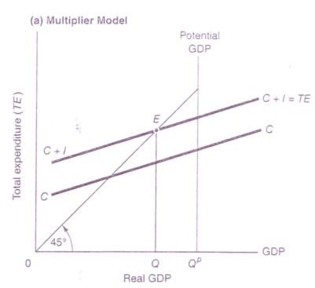
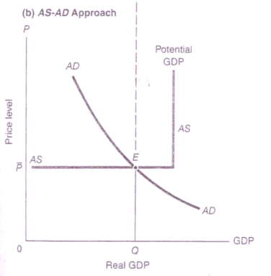

The multiplier model is a way of understanding the workings of the AS-AD equilibrium.
(a) The top panel shows the output expenditure equilibrium in the multiplier model, At point E the spending line lust cuts the 45° line, leading to equilibrium output of Q
(b) The equilibrium can also be seen in the bottom Panel, where the AD curve cuts the AS curve at point E. In the simplest multiplier model, wages and prices are as summed to be fixed, so the AS curve is horizontal until full employment is reached. Both approaches lead to exactly the Same equilibrium output, Q.

Slide 36
Cont.,
The same economy can be described by the multiplier diagram in the top panel of Figure 24-5.
The multiplier equilibrium gives the same level of output as the AS-AD equilibrium—both lead to a real GDP of Q. They simply stress different features of output determination.

Slide 37
Cont.,
This discussion again points to a crucial feature of the multiplier model. While it may be a highly useful approach to describe depressions or even recessions, it cannot apply to periods of full employment.
Once factories are operating at full capacity and all workers are employed, the economy simply cannot produce more output.

Slide 38
Fiscal Policy in the Multiplier Model
For centuries, economists have understood the allocational role of fiscal policy (government tax and spending programs).
It has long been known that fiscal programs are instrumental in deciding how the nation’s output should be divided between collective and private consumption and how the burden of payment for collective goods should be divided among the population.

Slide 39
Cont.,
Only with the development of modern macroeconomic theory has a further surprising fact been uncovered: Government fiscal powers also have a major macroeconomic impact upon the short-run movements of output, employment, and prices.
The knowledge that fiscal policy has powerful effects upon economic activity led to the Keynesian approach to macroeconomic polity, which is the active use of government action to moderate business cycles.

Slide 40
How Government Fiscal Policies Affect Output
To understand the role of government in economic activity, we need to look at government purchases and taxation, along with the effects of those activities on private sector spending.
We now modify our earlier analysis by adding G to C + I to get a new total expenditure curve TE = C + I + G. This new schedule can describe the macroeconomic equilibrium when government, with its spending and taxing.

Slide 41
Cont.,
It will simplify our task in the beginning if we analyze the effects of government purchases with total taxes collected held constant (taxes that do not change with income or other economic variables are called lumpsum taxes).
But even with a fixed dollar value of taxes, we can no longer ignore the distinction between disposable income and gross domestic product.
Under simplified conditions (including no foreign trade, transfers, or depreciation), we know from Chapter 21 that GDP equals disposable income plus taxes.
But with tax revenues held constant, GDP and D1 will always differ by the same amount; thus, after taking account of such taxes, we can still plot the CC consumption schedule against GDP rather than against DL.

Slide 42
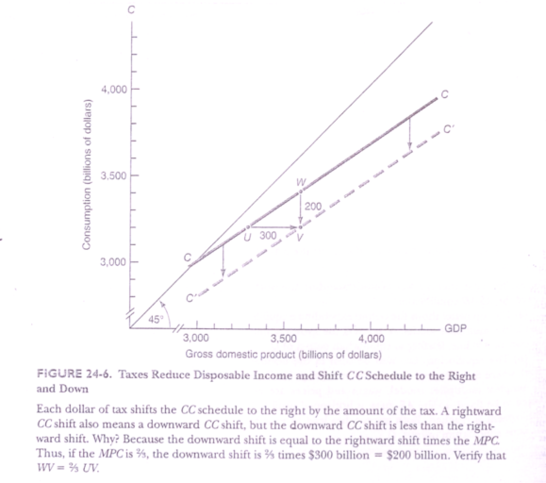

Slide 43
Cont.,
Turning next to the different components of aggregate demand, recall from Chapter 21 that GDP
consists of four elements:
GDP = consumption expenditure
+ gross private domestic investment
+ government purchases of goods and
services
+ net exports
= C + 1 + G + X
For now, we consider a closed economy with no foreign trade, so our GDP consists of the first three components, C + I + G. (We add the Final component of net exports when we consider open-economy macroeconomics.) Figure 24—7 shows the effect of including government purchases.

Slide 44
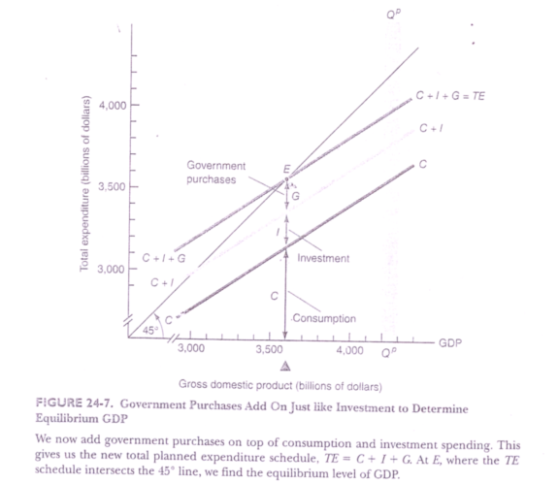

Slide 45
Cont.,
Here, we have added a new expenditure stream, G. to the consumption and investment amounts. Diagrammatically, we place the new variable, G (government purchases of goods and services), on top of the consumption function and the fixed amount of investment. The vertical distance between the C+ I line and the new TE = C + I + G line is just the quantity of G.

Slide 46
Cont.,
Why do we simply add G on the top? Because spending on government buildings (G) has the same macroeconomic impact as spending on private buildings (I); the collective expenditure involved in buying a government vehicle (G) has the same effect on jobs as private consumption expenditures on auto mobiles (C).

Slide 47
Cont.,
We end up with the three—layer cake of TE = C + I + G, calculating the amount of total spending forthcoming at each level of GDP. We now must go to its point of intersection with the 45° line to find the equilibrium level of GDP.
At this equilibrium GDP level, denoted by point E in Figure 24-7, total planned spending exactly equals total planned output.
Point E is thus the equilibrium level of output when we add government purchases to the multiplier model.

Slide 48
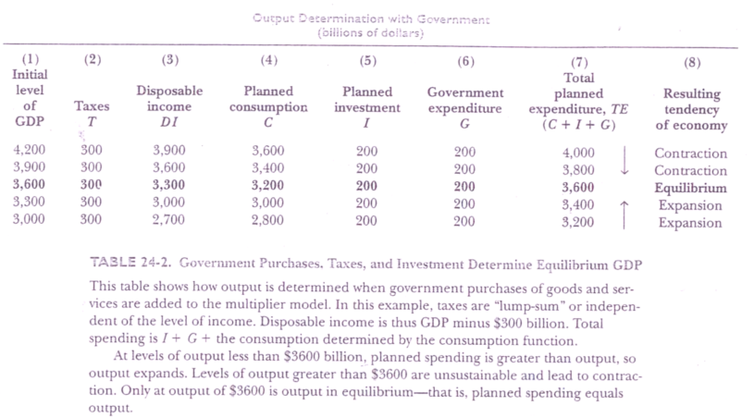

Slide 49
Fiscal-Policy Multipliers
The multiplier analysis shows that government fiscal policy is high—powered spending much like investment.
The parallel suggests that fiscal policy should also have multiplier effects upon output. And this is exactly right.

Slide 50
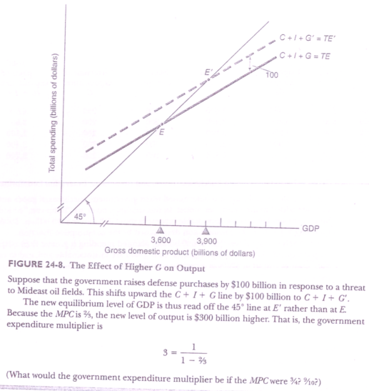

Slide 51
Cont.,
To sum up :
Government purchases of goods and services (G) are an important force in determining output and employment.
In the multiplier model, if G increases output will rise by the increase in G times the expenditure multiplier. Government purchases therefore have the potential to stabilize or destabilize output over the business cycle.

Slide 52
Impact of Taxes
Taxes also have an impact upon equilibrium GDP, al though the size of tax multipliers is smaller than that of expenditure multipliers. Consider the following example: Suppose the economy is at its potential GDP and the nation raises defense spending by $200 billion.
Such sudden increases have occurred at many points in the history of the United States in the early 1940s for World War II, in 1951 for the Korean war, in the mid-1960s for the Vietnam war, and in the early 1980s during the Reagan administration's military buildup.
Further more, say that economic planners wish to raise taxes just enough to offset the effect on GDP of the $200 billion increase in G. How much would taxes have to be raised?

Slide 53
Cont.,
We are in for a surprise. To offset the $200 billion increase in G, we need to increase tax collections by more than $,200 billion. In our numerical example, we can End the exact size of the tax, or 7; increase from Figure 24-6. That figure shows that a $300 billion increase in T reduces disposable income by just enough to produce a consumption decline of $200 billion when the MPC is %. Put differently, a tax increase of $300 billion will shift the CC curve down by $200 billion.
Hence, while a $1 billion increase in defense spending shifts up the C + I’+ G line by $1 billion, a Sl billion tax increase shifts down the C + I + G line by only 3% billion (when the MPC is %). Thus offsetting an increase in government purchases ret; tires an increase in T larger than the increase in G.

Slide 54
Cont.,
Tax changes are a powerful weapon in affecting output. But the tax multiplier is smaller than the expenditure multiplier bw at laetor equal to the MPC:
Tax multiplier = MPC X Expenditure Multiplier
The reason the tax multiplier is smaller than the expenditure multiplier is straightforward. When government spends $1 on G, that $1 gets spent directly on GDP.
On the other hand, when government cuts taxes by a dollar, only part of that dollar is spent on G while a fraction of $1 tax cut is saved. The difference in the responses to a dollar of G and to a dollar of T is enough to lower the tax multiplier below the expenditure multiplier

Slide 55
Multipliers in Action
A realistic understanding of the size of multipliers is a crucial part of diagnosis and prescription in economic policy. Just as a physician prescribing a painkiller must know the effect of different dosages, so an economist must know the quantitative magnitude of expenditure and tax multipliers.
When the economy is growing too rapidly and a dose of fiscal austerity is prescribed, the economic doctor needs to know the actual size of multipliers before deciding how large a dose of tax increases or expenditure reductions to order.

Slide 56
Beyond the Multiplier Model
We have completed our survey of the most important applications of the Keynesian multiplier model. This approach is an indispensable aid in understanding business fluctuations and the linkage between government fiscal policy and national output.
But it would be a mistake to believe you can turn a parrot into a macroeconomist by simply teaching it to say “C + 1+ G." Macroeconomic understanding requires understanding not just the models but also their strengths and weaknesses. Among the simplifications
Of the simplest multiplier model are the following:
The multiplier model ignores the impact of money and credit upon consumption and investment.
The simplest multiplier model ignores the way foreign trade affects output at home and abroad.
Aggregate supply is left out of the story, so we have no way of analyzing how increases in spending are divided between prices and output.

